Slide 1

Predict Students' Dropout and Academic Success
Submitted by
Akshit Rai (2011981289)
Amit Aswal (2011980501)
Krish Tapwal (2011981212)
Sagar Mishra (2011980524)
Supervised By
Mr. Shivam Singh

Slide 2
PROBLEM STATEMENT
The aim of this project is to contribute to the reduction of academic dropout and failure in higher education, by using machine learning techniques to identify students at risk at an early stage of their academic path, so that strategies to support them can be put into place. The problem is formulated as a three category classification task (dropout, enrolled, and graduate) at the end of the normal duration of the course.

Slide 3
ABOUT DATASET
A dataset is created from a higher education institution (acquired from several disjoint databases) related to students enrolled in different undergraduate degrees, such as agronomy, design, education, nursing, journalism, management, social services, and technologies. The dataset includes information known at the time of student enrollment (academic path, demographics, and social-economic factors) and the students' academic performance at the end of the first and second semesters. The dataset consist of 36 attributes and 4424 instances.

Slide 4
EXPLORATORY DATA ANALYSIS
Data exploration gives us lot of information about the data and helps us to analyze the data statistically. Statistical analysis helps us to understand the relation between different types of data, it helps us to realize how each feature are related to each other, it helps us to understand the amount of variation in each feature, it also helps us to understand the distribution of each category and last but not the least it helps us to understand how much each input variables are contributing towards the target variable.

Slide 5
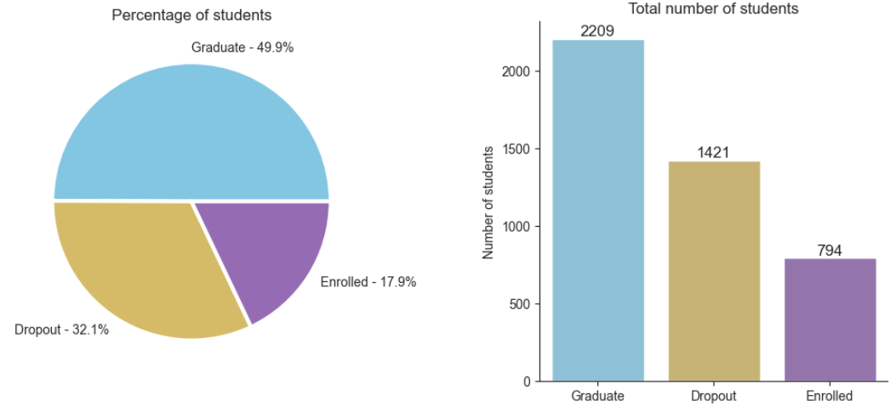
ANALYSIS OF TARGET VARIABLE
From this pie chart, we can observe that around 49.9% of the students are graduated, 32.1% students are dropout, and 17.1% of the students are enrolled in some other course, which indicates that half of the students from the total population are graduated.

Slide 6
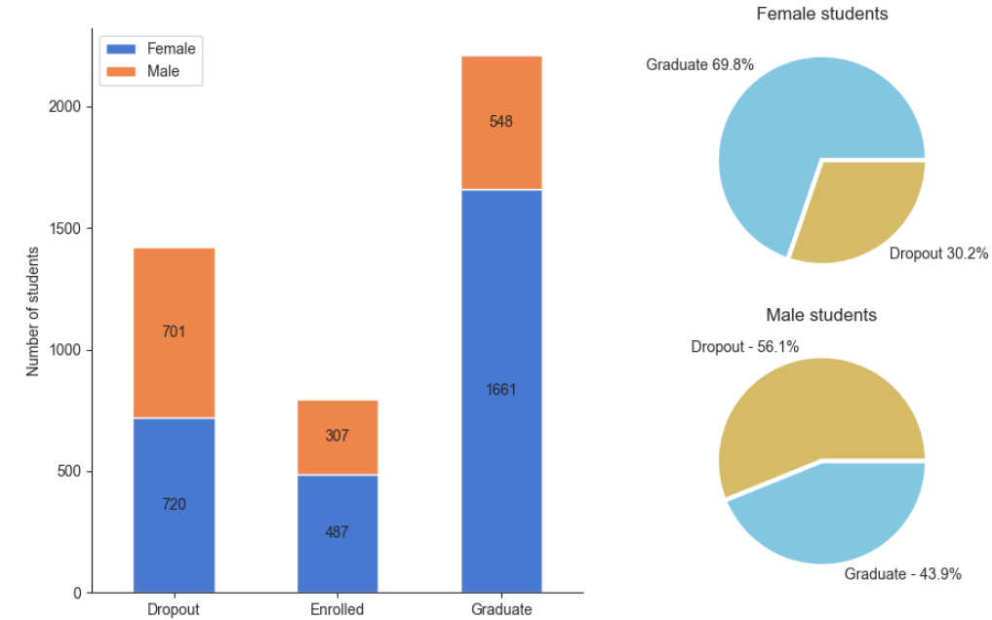
ANALYSIS OF TARGET VARIABLE WITH GENDER
Around 43.9% are Graduate Male while
56.1% are Dropouts.
In case of Female students 69.8% are Graduate and only 30.2% had dropped out.

Slide 7
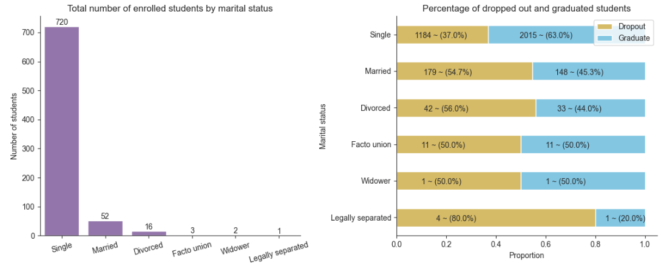
ANALYSIS OF TARGET VARIABLE WITH MARTIAL STATUS
The majority of enrolled students are single.
The percentage of single students who graduated is higher than the percentage of students who dropped out.
Students with a marital status Legally separated have the highest percentage of dropouts.
The distribution of dropout and graduate students within other groups is similar and no pattern can be seen.

Slide 8
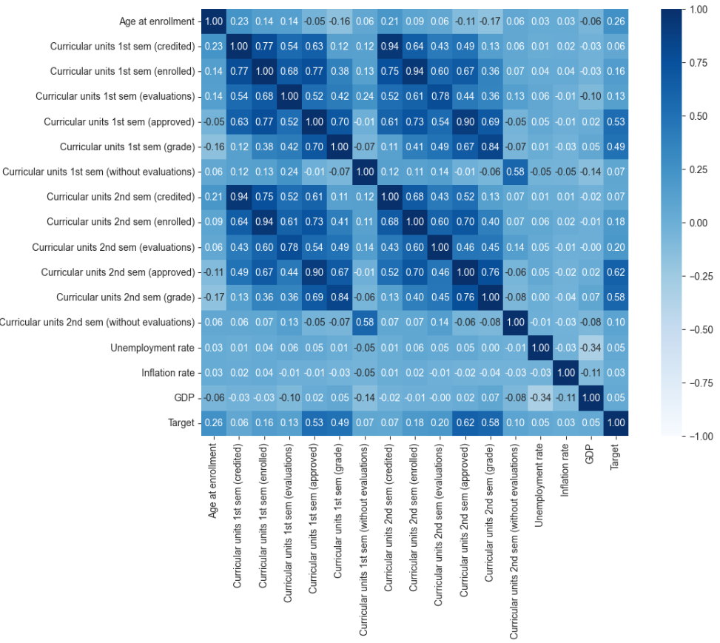
ANALYSIS OF NUMERICAL DATA
From the above plot, we are getting some interesting insights about the dataset and those insights are following.
Curricular_units_1st_sem_(grade) & Curricular_units_2nd_sem_(grade) is having strong correlation between them and correlation value is 0.84.
Previous qualification (grade) & Admission grade is having average relation between them since the correlation value is 0.58.
And the final observation from this
Heatmap is Unemployment rate, inflation rate, and GDP are having negative relation between them.

Slide 9
ANALYSIS OF CATEGORICAL DATA
In categorical data, we can observe that each data contains so many distinct categories; there are only few variables where we are having just 2, 3, 4 or 5 categories. Although we have analysed all these variables with the count plot and got some interesting insights. Some of those insights are as following:
The majority of students who enrolled themselves for any course are belonging to the age group in between 18-20.
Majority of the students in a group have taken the nursing, followed by management course, social services, journalism and communication.
We can observe that more than 90% of students submitted their tuition fees on time and we analysed that the students who have not submitted the tuition fees on time, they are having a higher chance of dropping out.
We can observe that maximum students are female but interestingly males are having a higher chance of dropping out.

Slide 10
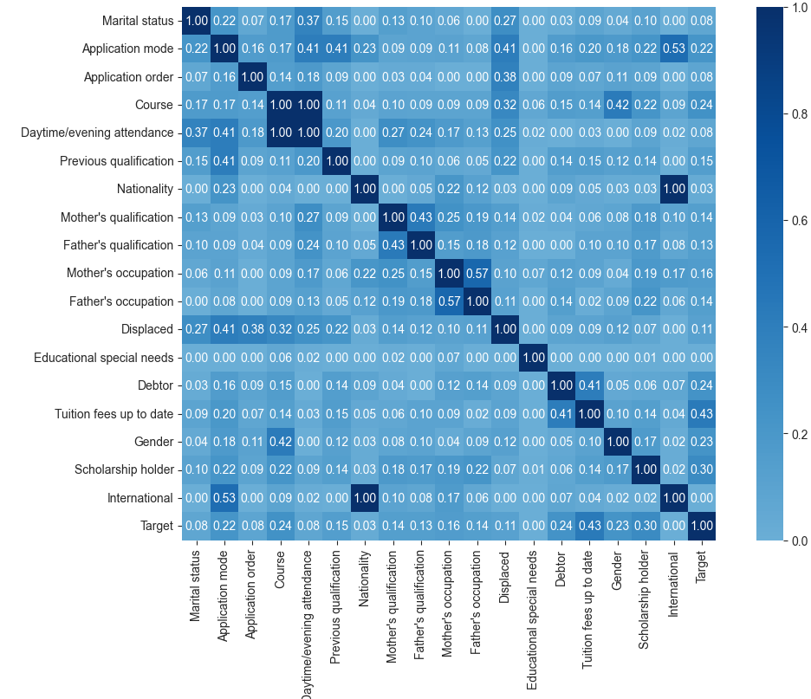
HEAT MAP FOR CATEGORICAL DATA

Slide 11
FEATURE ENGINEERING
Feature engineering is the ‘art’ of formulating useful features from existing data following the target to be learned and the machine learning model used. It involves transforming data to forms that better relate to the underlying target to be learned. The following techniques we have employed on our dataset.
Handling Categorical Data: We have handled the categorical data using Label Encoding technique.
Handling Outliers: The dataset contains an outlier and to handle that we have used IQR (Interquartile Range).
Feature Selection: For selecting the best feature in a dataset, we have used Chi-Square test and drop those features which is independent to target variable.

Slide 12
BALANCING THE DATA
As we have observed earlier at a time of analysis that the data is quite imbalanced in nature, so it’s very important to balance the data and to balance the data we are using a SMOTE (Synthetic Minority Oversampling Technique). It creates new synthetic observations without replicating the same observation and for creating those synthetic observations it uses a KNN (K-Nearest Neighbor) technique and that’s why this technique is more optimized and stable than any other sampling technique.

Slide 13
PROPOSED MACHINE LEARNING ALGORITHMS
Decision Tree: A decision tree is non-parametric supervised learning algorithm, which is utilized for both regression and classification task. It has hierarchical tree like structure which consist of root node, internal node and leaf node.
Random Forest: Random Forest is an ensemble learning method which can be utilized for both classification and regression task. Random Forest is a powerful and versatile supervised machine learning algorithm that grows and combines multiple decision trees to create a “forest.”
XGB Classifier: XG Boost is again a very popular and effective ensemble learning technique. The beauty of this powerful algorithm lies in its scalability, which drives fast learning through parallel and distributed computing and offers efficient memory usage.
SVM: SVM algorithm is to create the best line or decision boundary that can segregate n-dimensional space into classes so that we can easily put the new data point in the correct category in the future. This best decision boundary is called a hyperplane.
Logistics Regression: Logistic regression is a supervised machine learning algorithm mainly used for classification tasks where the goal is to predict the probability that an instance of belonging to a given class or not. It is a kind of statistical algorithm, which analyze the relationship between a set of independent variables and the dependent binary variables.

Slide 14
PERFORMANCE METRICS
Accuracy Score: It is calculated as total number of correctly classified points divided by total number of points is test set.
Precision Score: Precision is calculated as the ratio of correctly classified positive points (True Positives) to the total number of correctly classified positive points (True Positives + False Positives).
Recall Score: Recall tells us what proportion of the positive class got correctly classified. It is calculated as the total number of true positive points divided by true positive and false negative.
F1-score: In Precision, we are focusing more on false positive values where as in case of recall we focused on false negative value. Now, if we want to minimize false positive as well as false negative both then we can use f1-score. It is calculated as harmonic mean of precision and recall.

Slide 15
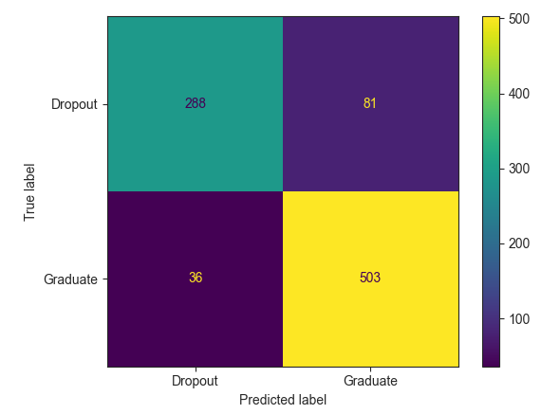
CONFUSION MATRIX (LOGISTIC REGRESSION)
Confusion Matrix can give us the visual representation of total sum of correctly classified points and sum of misclassified points.

Slide 16
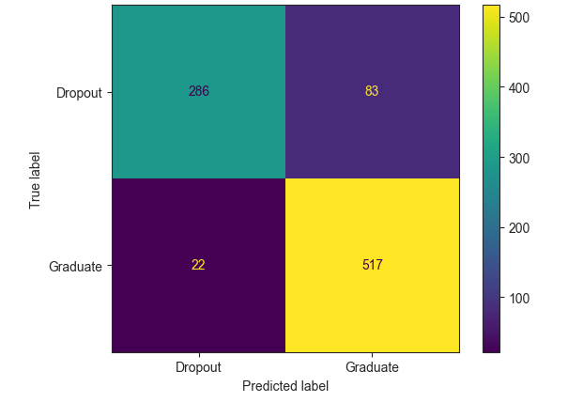
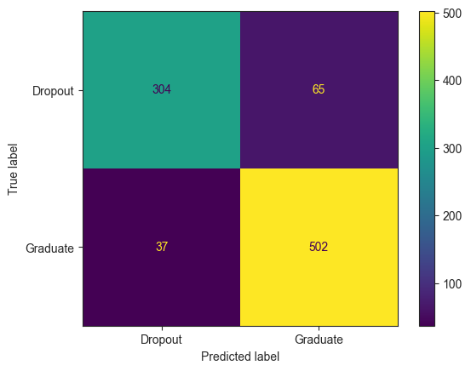
CONFUSION MATRIX (SVM & DECISION TREE)
SVM
XG BOOST

Slide 17
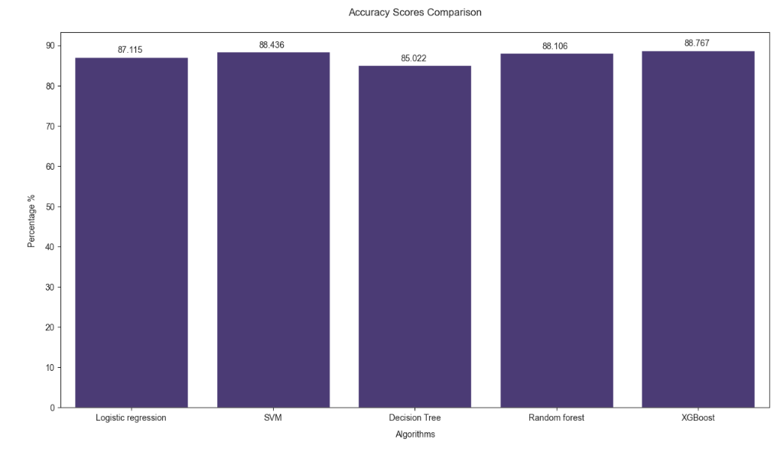
PERFORMANCE COMPARISON

Slide 18
THANK YOU !!!

